Slide 1
CARMA in the ALMA era
CARMA is well-suited for mapping large fields, extended objects; unique capabilities at 30 GHz
testbed for new instrumentation and techniques
student training

Slide 2
GMCs in M33

Slide 3
22’’ FWHM ALMA primary beam at 230 GHz

Slide 4
900 pointings required!

Slide 5
mosaicing sensitivity ~ nD
array | n D (meters)
CARMA | 145
PdBI | 90
ALMA | 600
ACA | 84
use CARMA to locate interesting sources;
use ALMA to map them with higher resolution

Slide 6
largest scale that can be imaged interferometrically ~ λ/Bmin
source detected
source resolved out

Slide 7
comparison of largest scales
array | shortest spacing | largest scale 30 GHz | largest scale 230 GHz
CARMA | 4.2 m | 8.2’ | 64’’
PdBI | 24 m | -- | 11’’
ALMA | 15 m | -- | 18’’
ACA | 9 m | -- | 30’’
EVLA | 35 m | 1’ | --

Slide 8
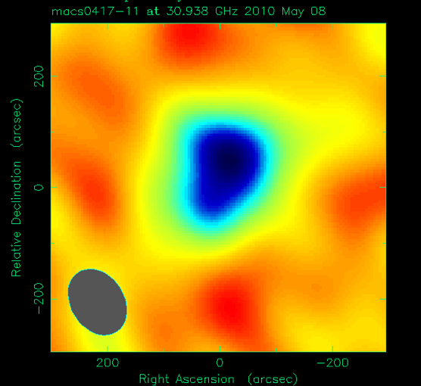
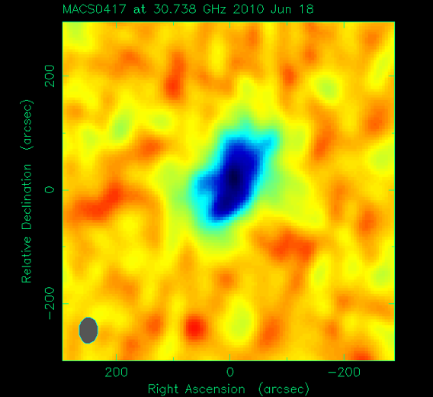
science cases for extended structures: 1 - SZ observations of clusters
study gas in outskirts of cluster where X-ray emission is weak
SZ-mass scaling, mergers, AGN feedback, etc.
SZA only
15 element hybrid – Jun 2010
Text

Slide 9
2 - turbulent structure in molecular clouds
simulated 3-2 CCS observations, 96 hrs integration
recover power spectrum from 5’’ to 500’’

Slide 10
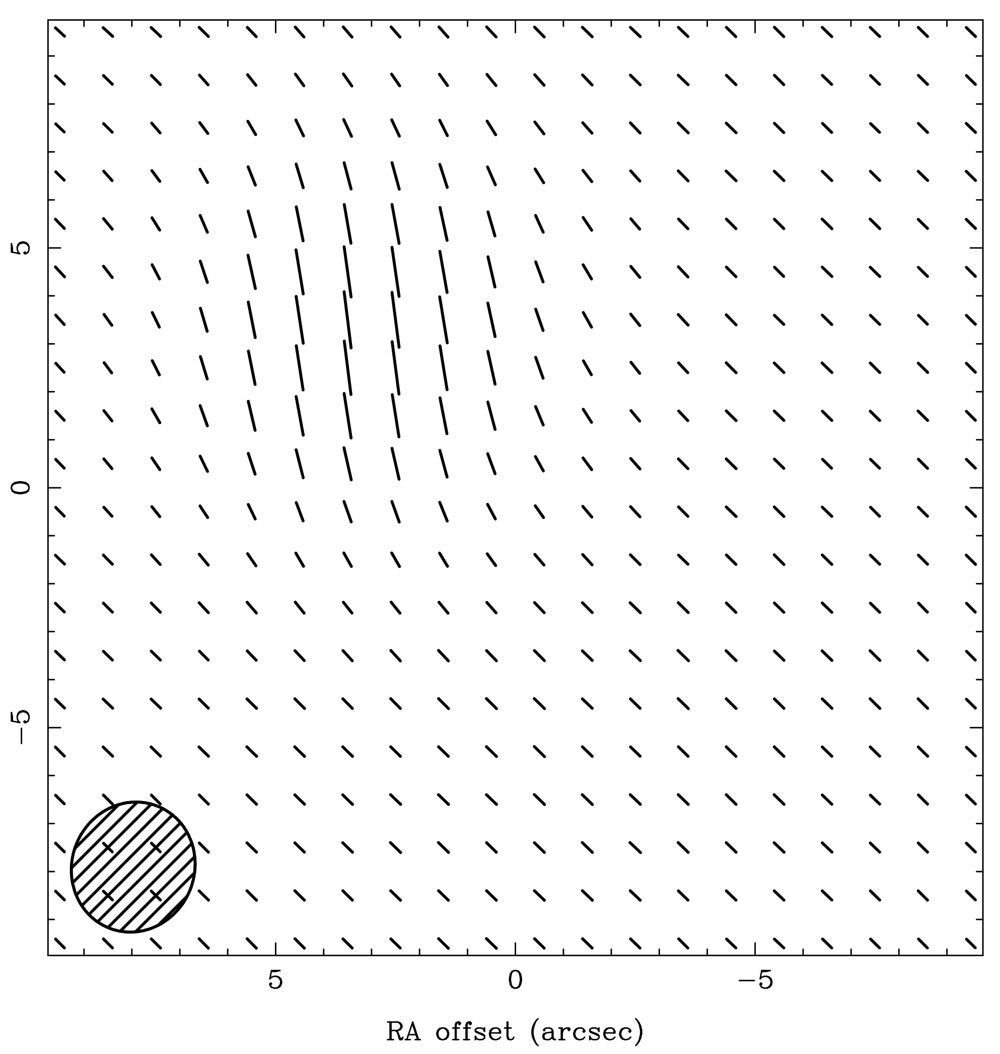
3 - dust polarization
model
simulated BIMA C-array obs
without short spacings, get the WRONG answer -
PA wrong; fractional pol 30% instead of 5%

Slide 11
CARMA as a testbed for new techniques
example: paired antenna calibration system – adaptive optics using 3.5-m telescopes
quasar
science target
3.5-m ant

Slide 12
PACS example
230 GHz maps from A-array (baselines to 1.9 km)
H30α recombination line toward BN, but not source I
without PACS
with PACS
BN
source I

Slide 13
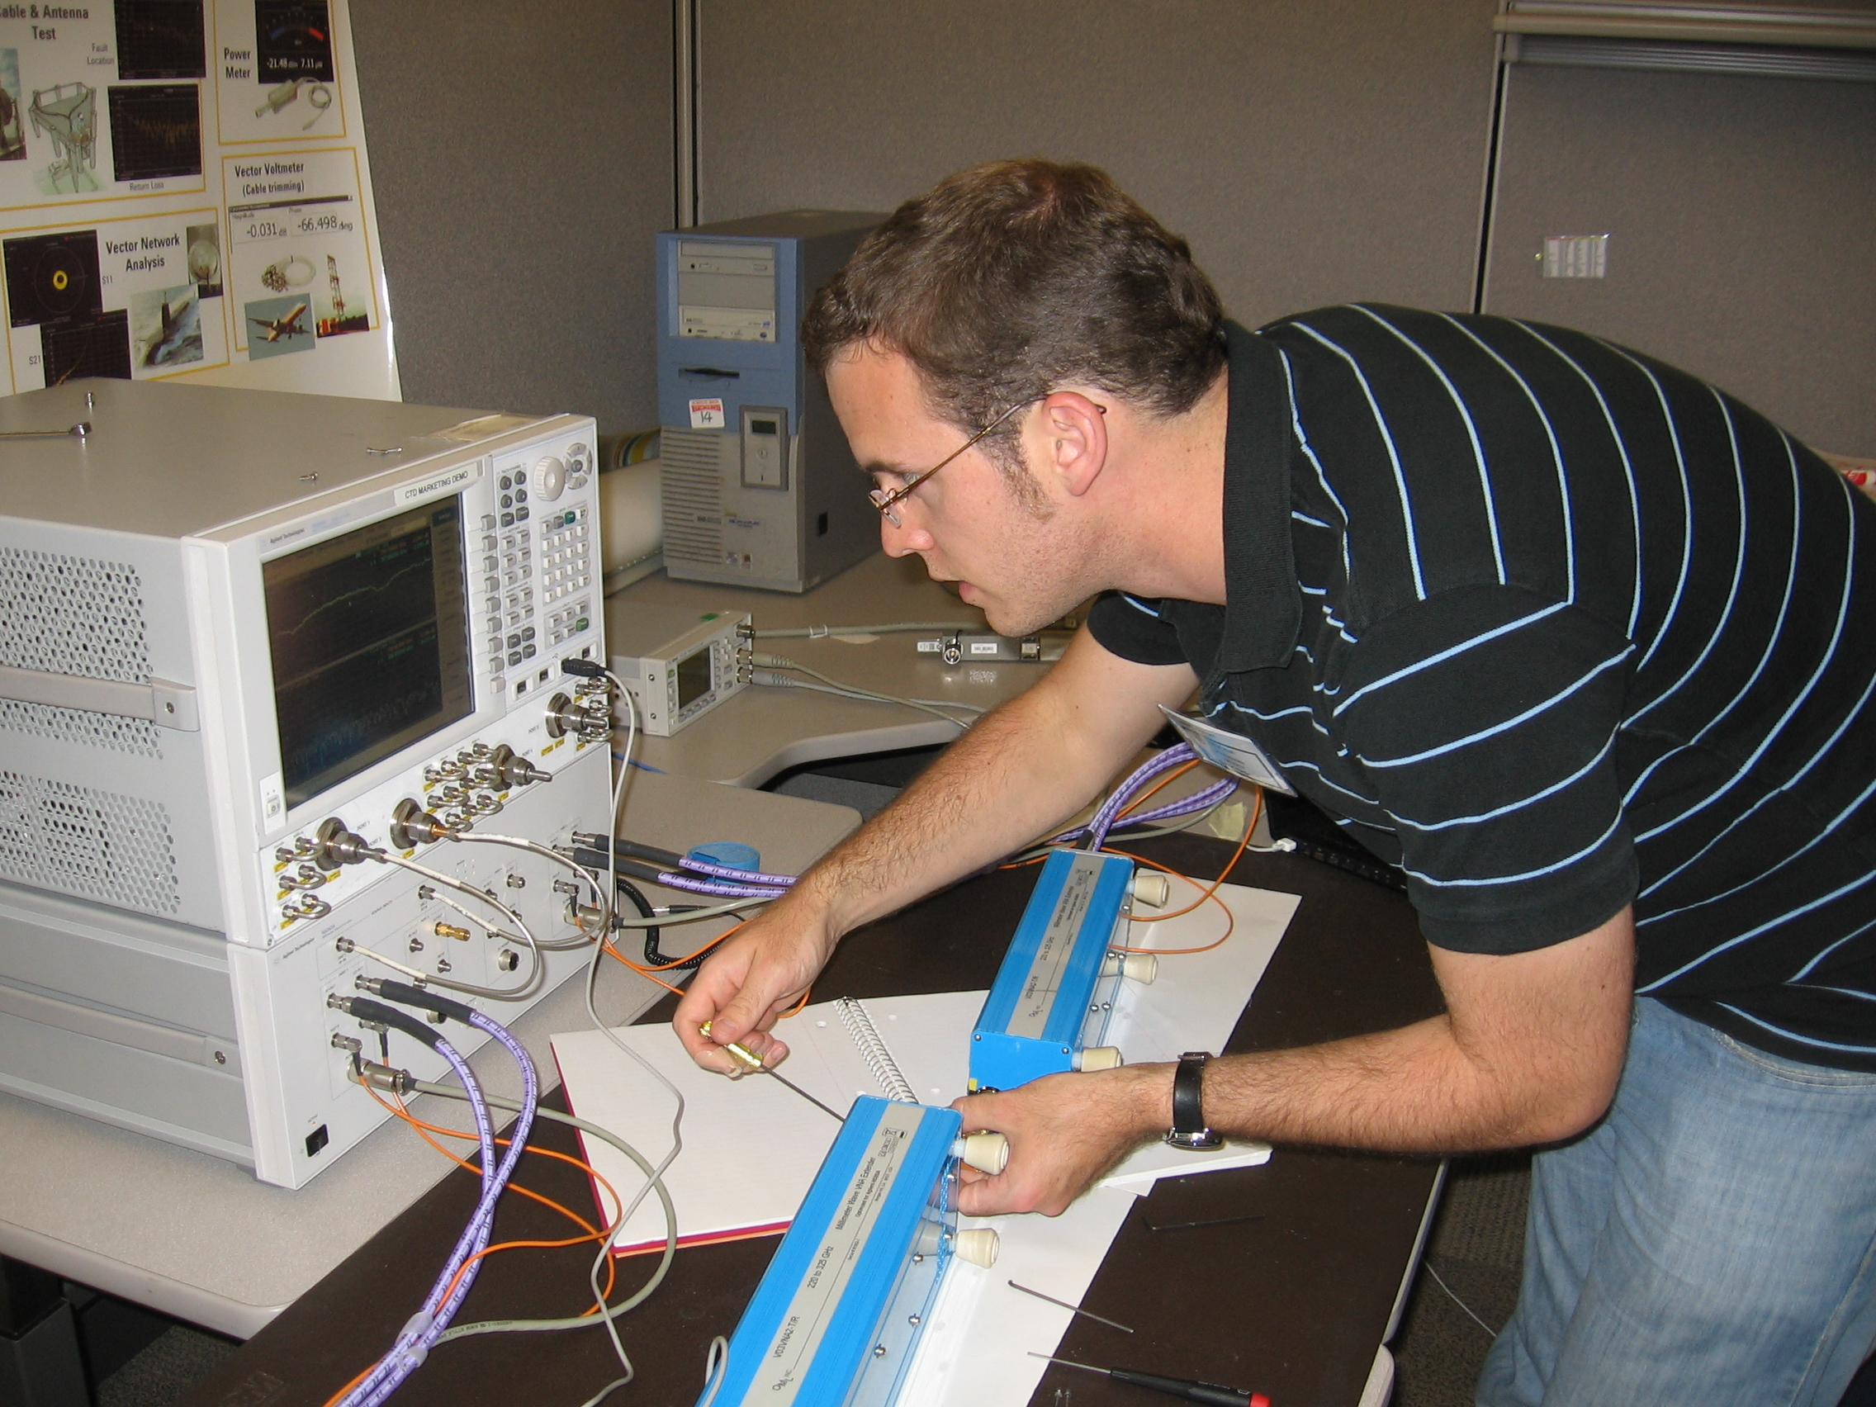
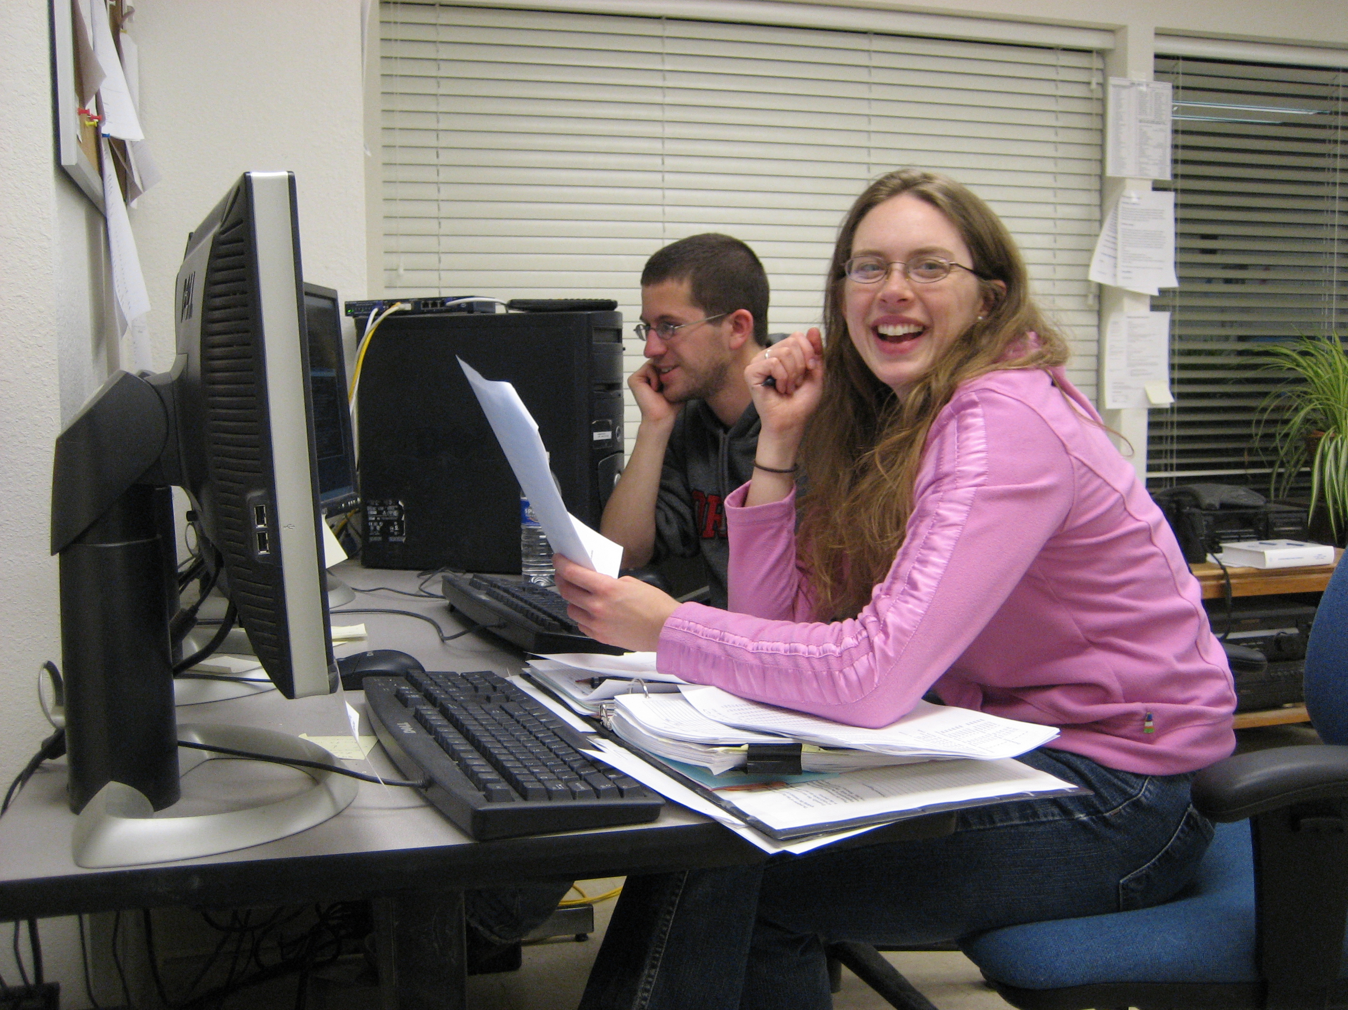
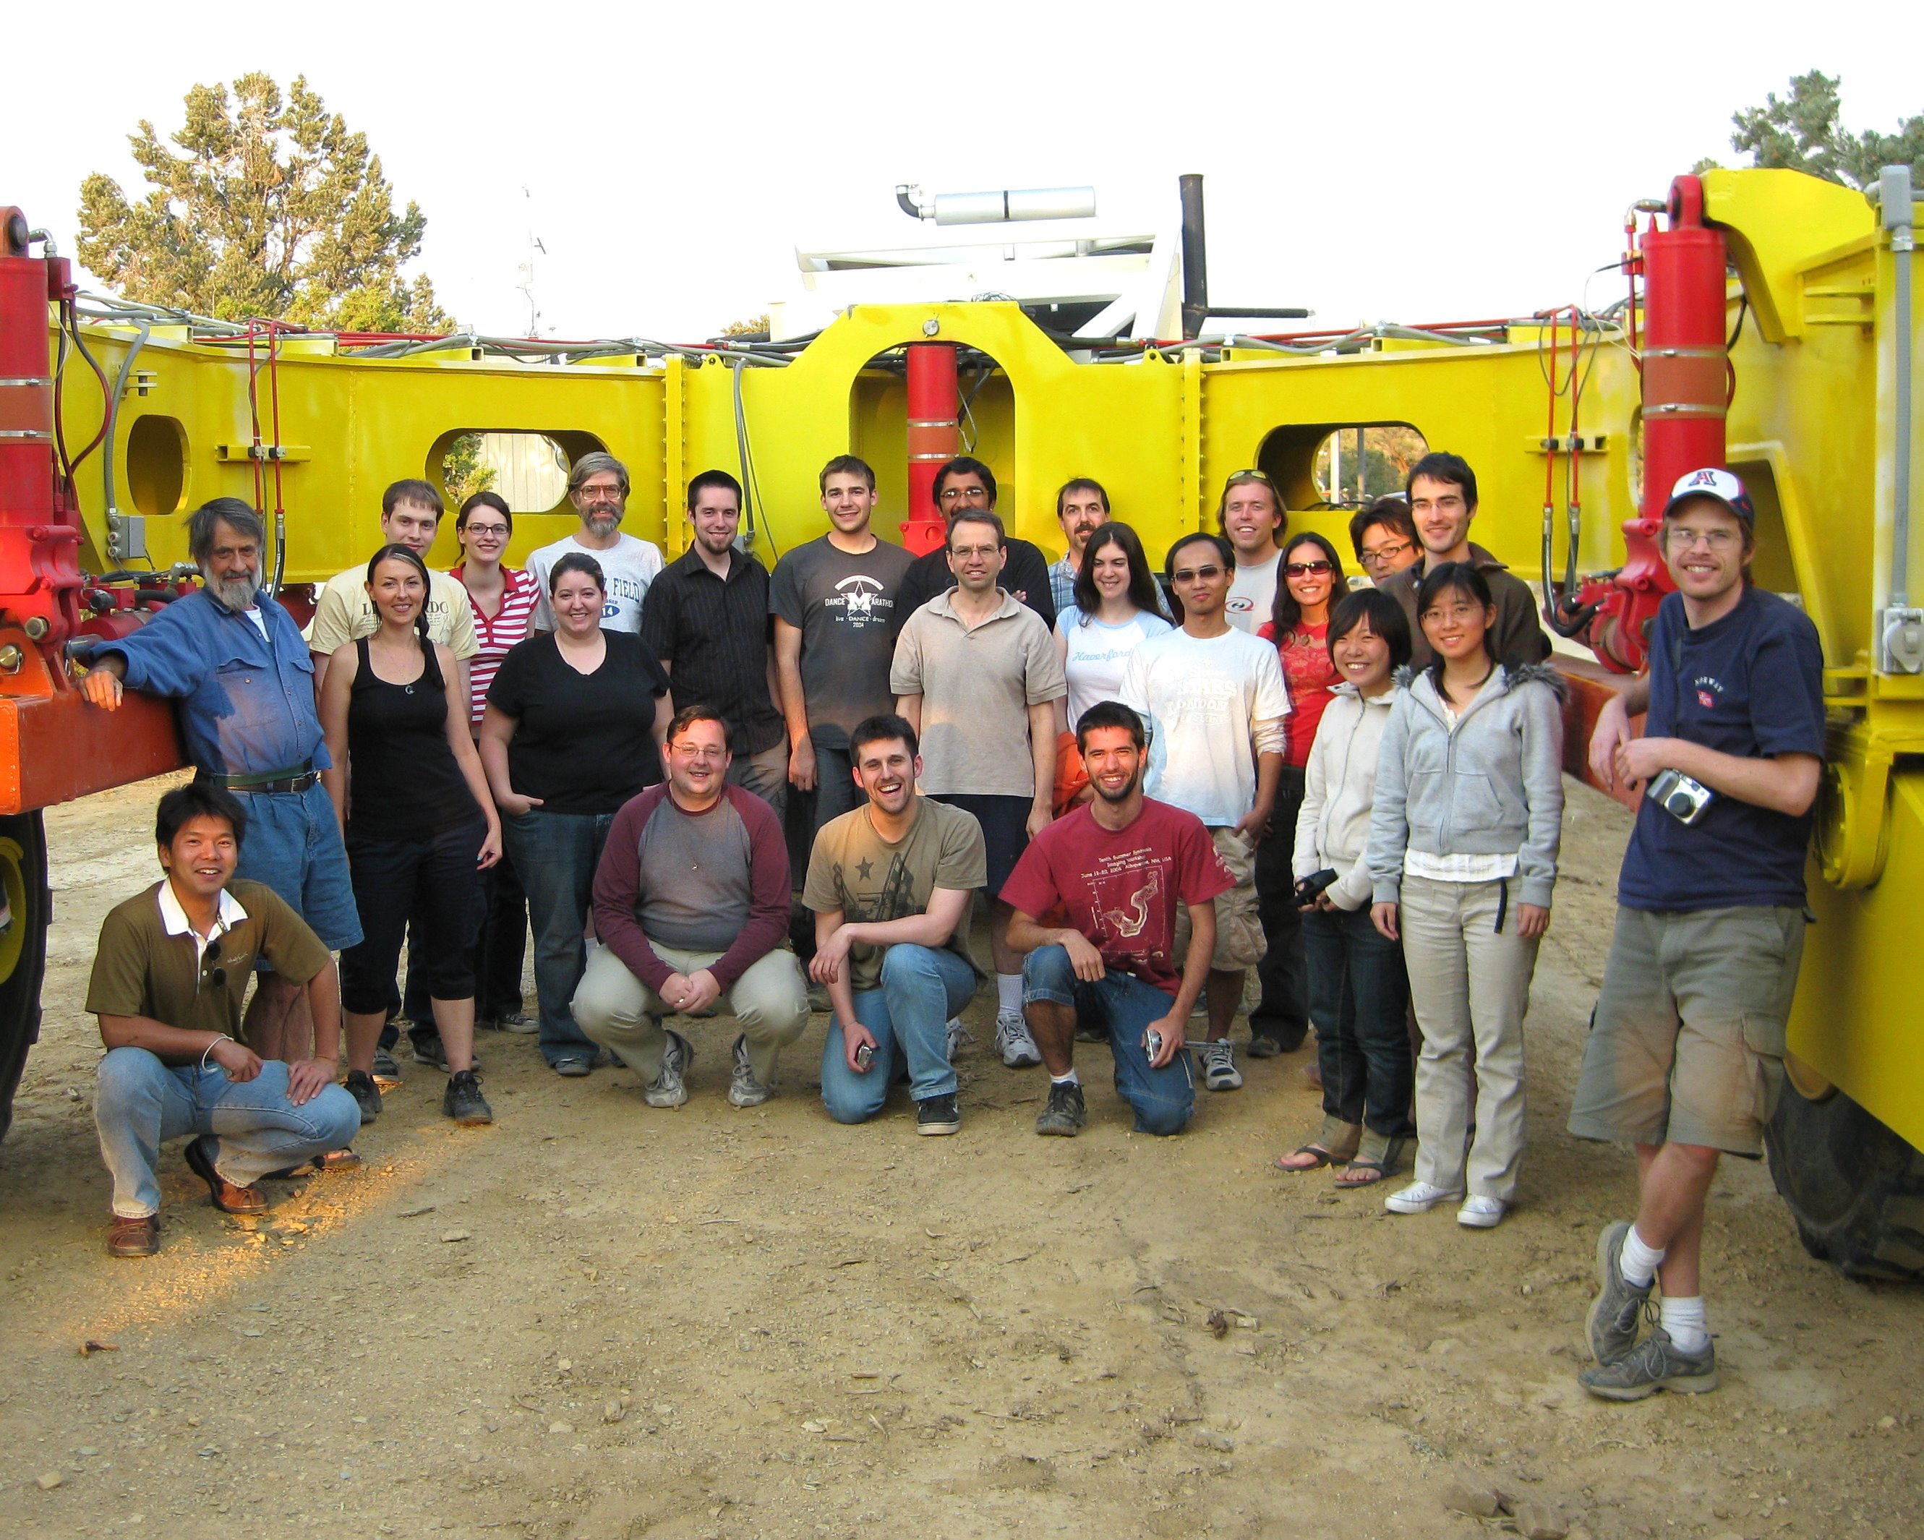
student training
student training

Slide 14
some current instrument developments
1mm dual circular pol receivers, full Stokes correlator ...enables dust polarization measurements in molecular clouds
VLBI beamformer (ATI grant to Haystack) ...enables factor of 4-8 SNR improvement for 1mm VLBI on SgrA*
IF switchyard ...enables 32 GHz bandwidth on 10.4-m antennas for higher sensitivity, redshift searches

Slide 15
MRI-funded developments
$3.9 M ($2.7M NSF + $1.2M matching)
install cm receivers on 6-m telescopes (reuse receivers from CBI experiment)
quadruple correlator size to handle 253 baselines x 8 GHz (reuse existing digital hardware)
...enables higher fidelity observations of SZ in clusters, widefield imaging

Slide 16
future
array receivers?
4 x 4 array achieves ALMA mapping speed
Tony Readhead, Caltech/JPL developing 3mm MMIC arrays
map nearby galaxies, molecular clouds
z-machine?
attach 253 x 8 GHz correlator to just 15 baselines -> 135 GHz bandwidth each
ultrawideband receivers for entire 3mm + 2mm (+ 1mm) spectrum (use Adrian Lee technology for splitting bands?)
measure 1’’ positions, CO redshifts of IR-detected galaxies

